Slide 1

Welcome to:
Open Forum Meeting
5:30PM Thursday, January 18, 2018
Broun Hall, Room 235

Slide 2




Agenda

Slide 3
Selection of Officers

Slide 4
Officers of SPARC
President
Matthew Castleberry (mtc0030@auburn.edu)
Vice-President
Josh Jablonowski (jdj0019@auburn.edu)
Lab Manager
Mike Petry (mbp0026@auburn.edu)
Outreach Coordinator
Matthew Zacune (maz0006@auburn.edu)
Secretary
Rebecca Thomas (rjt0010@auburn.edu)
Treasurer
Adam Havenkamp(alh0075@auburn.edu)

Slide 5
About SPARC

Slide 6
Introduction
Student lead organization at Auburn University.
Creates and fosters an environment of creativity and innovation through collaborative projects.
A place to test out ideas, integrate concepts learned in class, and learn skills that will be instrumental when working in the workforce.
No prior experience is required, only a willingness to learn.
Great for students of all ages and majors.
President: Matthew Castleberry

Slide 7


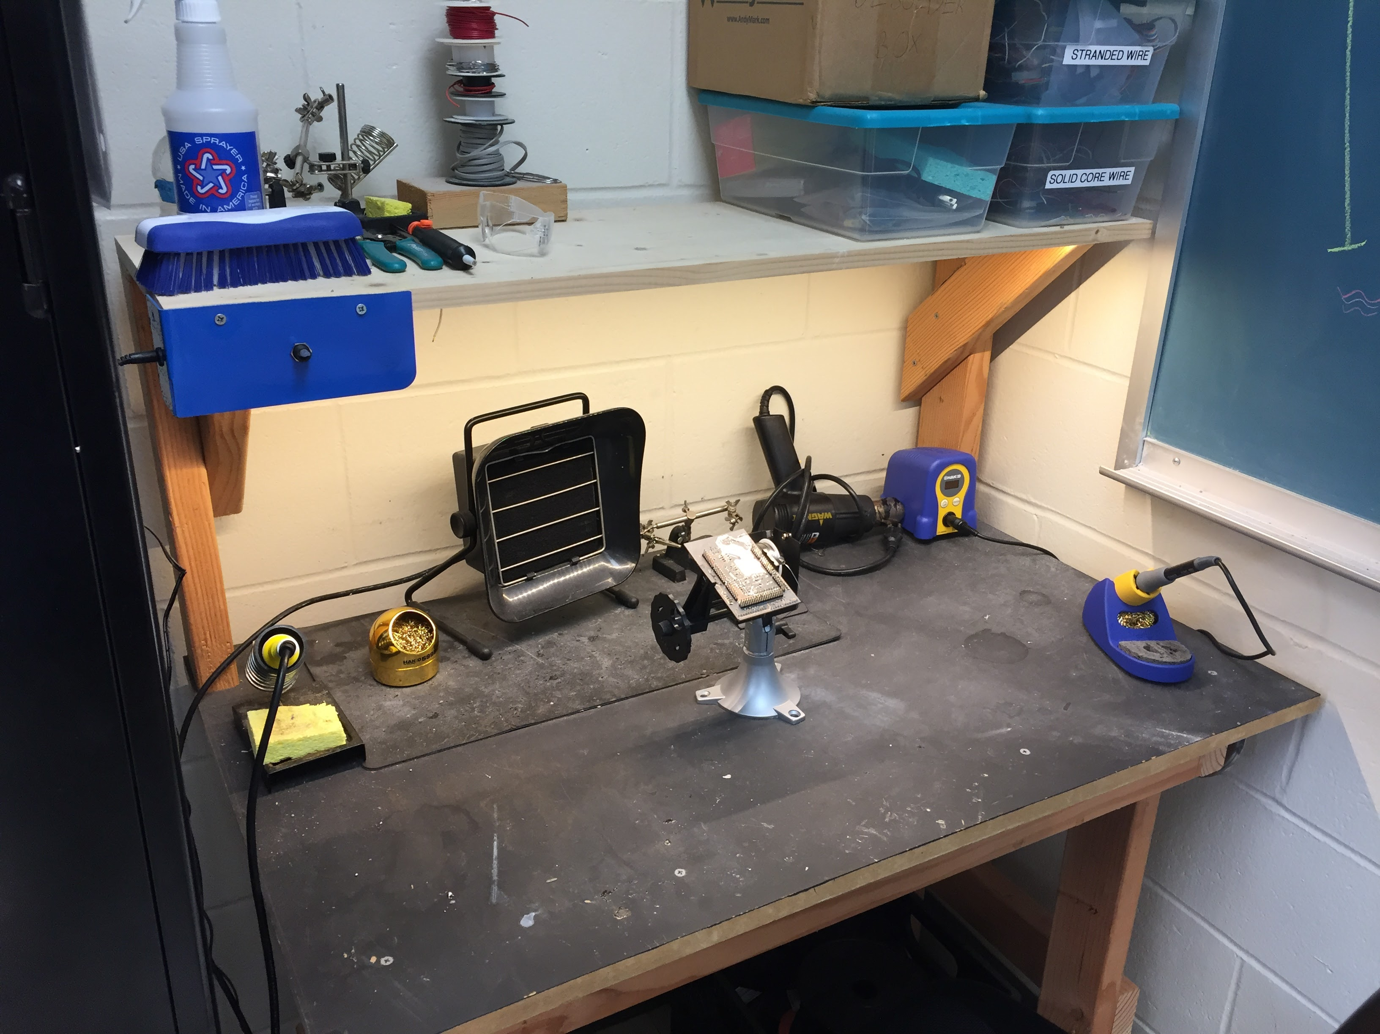
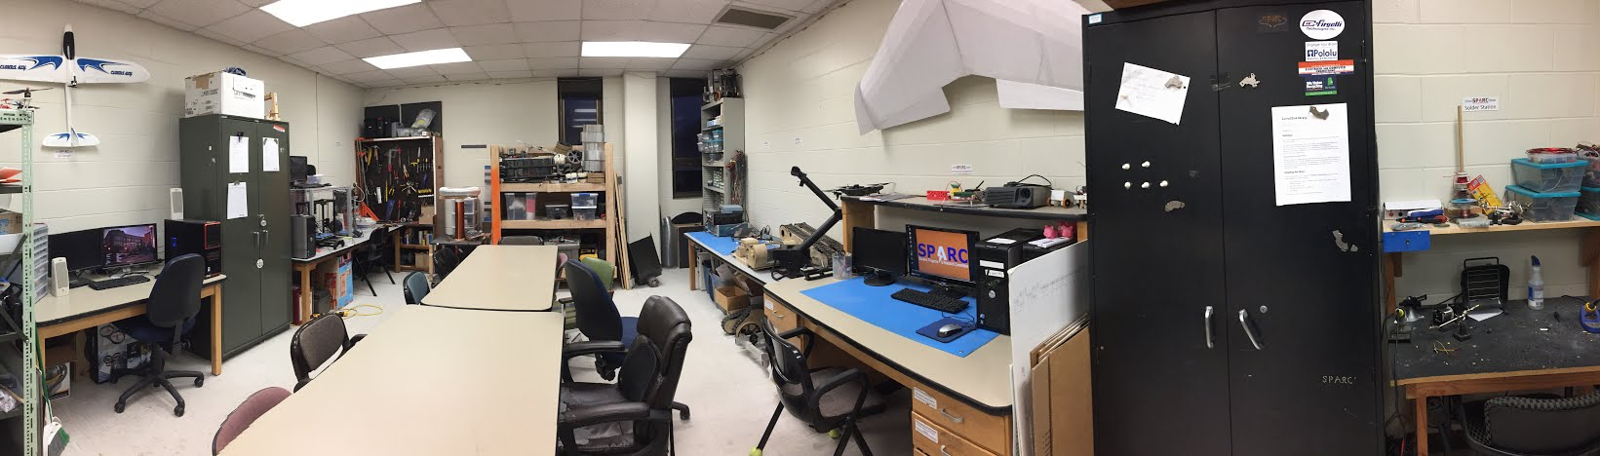
Our Lab
Broun Hall
Room: 367

Slide 8
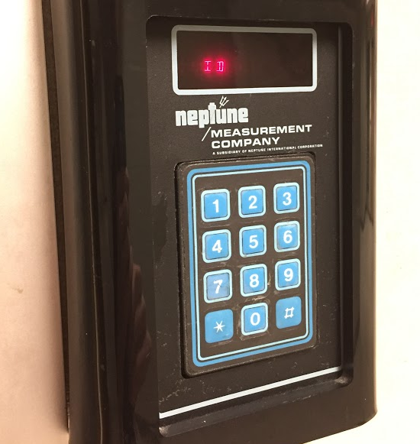
How to become a Member
Log 5 constructive hours in the lab
Write the times on the sheet on the clipboard next to the door.
Contact us at sparc.auburn@gmail.com
We will respond with the instructions to get an access code.

Slide 9
SPARC Meetings
Open Forum
Discuss status of active projects
Learn about and discuss specific topic in the realms of technology, engineering or making.
Wednesdays at 6:00 PM
Maker Training Session
Learn about a specific skills like 3D printing, CAD, electrical prototyping, and robotics.
Centered around SPARC Sumo Bot Competition
Tuesdays at 5:30 PM
Project Meetings
Project members come together to talk about detailed progress.
Meeting times and locations vary from project to project.

Slide 10
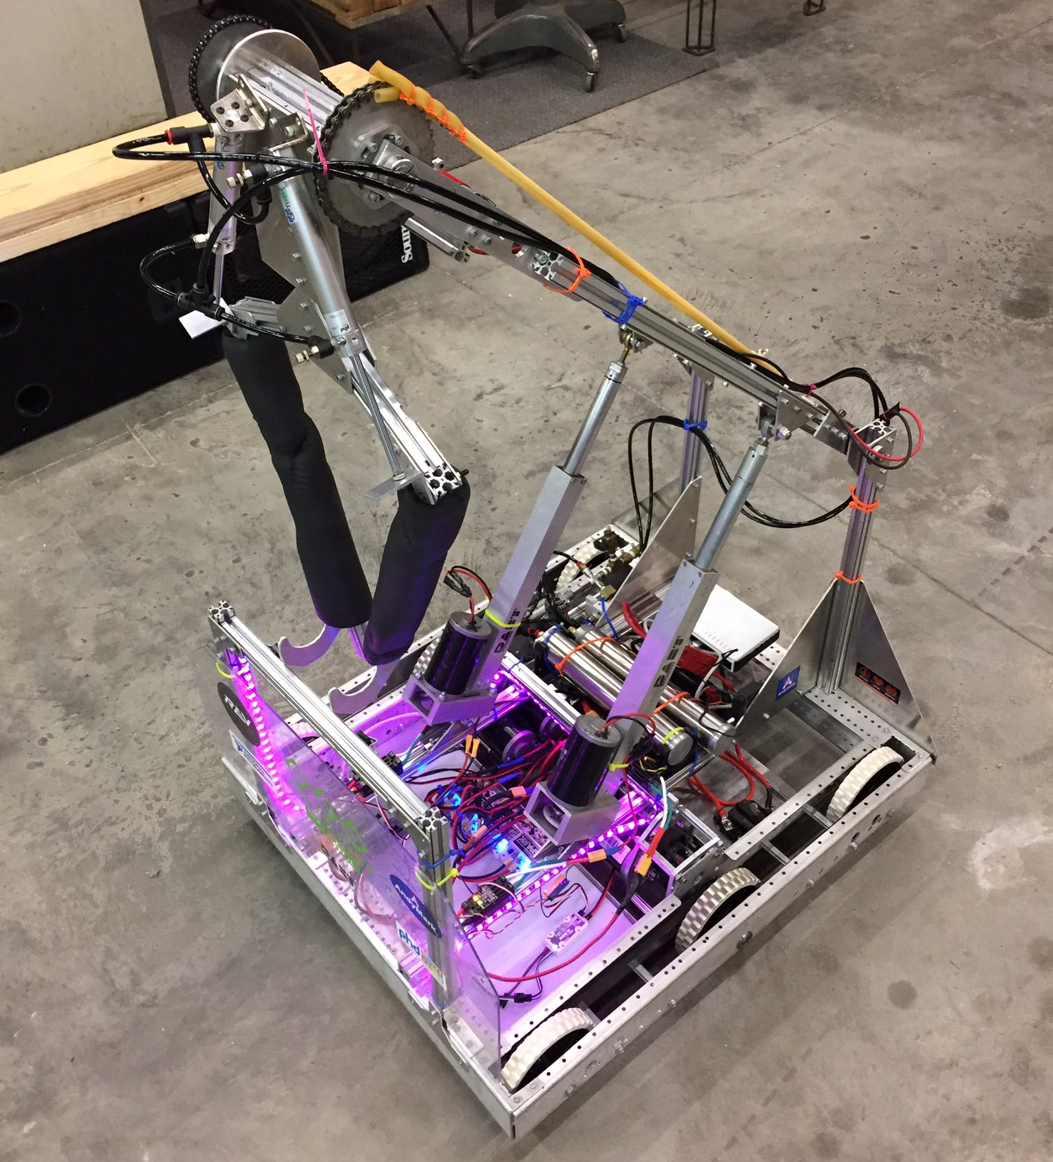
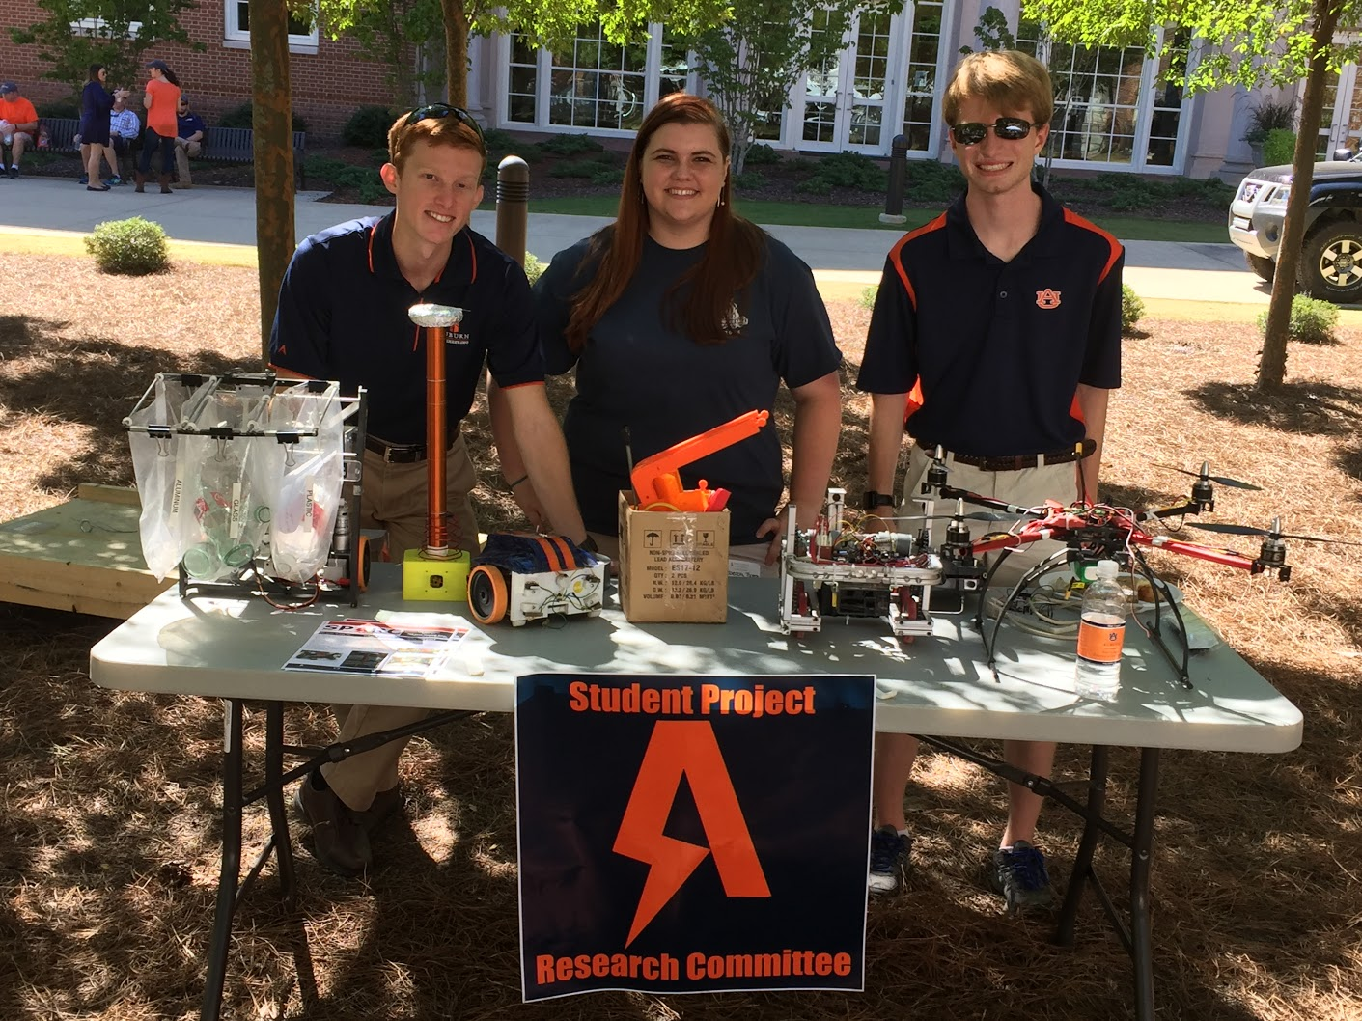
Outreach Events
Opelika HS FRC Team
Help mentor a FIRST Robotics Competition (FRC) Team
Mon Tue Thu: 3:30-6:30, Fri: 3:30-9:30, Sat:10-6
E-Day
Help display projects in Broun, Student Center, and Concourse to high school students.
Friday, February 23rd
Robot in 3 Days 2018 Bot
Engineering Tailgate 2016 SPARC Table
Notes:
Fall 2016
Loachapoka Robotics Mentoring- Mondays, Tuesdays, and Thursdays 3:00PM to 4:30PM
ECE Minority Presentation- November 14th
AJHS E-Day- November 17th
South’s Best- December 3-4th
SCORE Claw Machine- December 3-4th
Spring 2016
E-Day- Late February or early March
SPACE Day- Possible Event Next Semester
IEEE Sumo Robotics Competition (with local middle and high schools)- Spring 2017

Slide 11



Partner Organizations
NASA Robotics Mining Competition Team
President: Jeremy Frasher <jjf0010@auburn.edu>
Meets on Mondays 6-7, SPARC Lab, Broun 367
RC Hobbyist Club
President: Craig Legrand <cbl0019@auburn.edu>
Meets on Mondays TBD and Fridays 3:30-5:00, Broun 235
IEEE Auburn University Student Branch
President: Michelle Kniffen <mek0027@auburn.edu>
Meets on Mondays 5:30-6:30, Broun 238

Slide 12




More Information about SPARC
Website
http://sparc-auburn.github.io/
Github
https://github.com/SPARC-Auburn
Slack
https://sparc-auburn.slack.com/
Email
sparc.auburn@gmail.com

Slide 13
SPARC in 2018

Slide 14
What’s Staying the Same
Collaborative Projects
Friendly and Chill Atmosphere
Active Engagement
Learning Environment
Open Lab for Members

Slide 15
What’s Being Improved
Emphasis on three or four main projects
Lab Enhancements
Two Types of Meetings
Semester Long Competition
Access Code List Reset (Thurs, 1/25/18)
More Food at Meetings

Slide 16
Proposed Projects

Slide 17
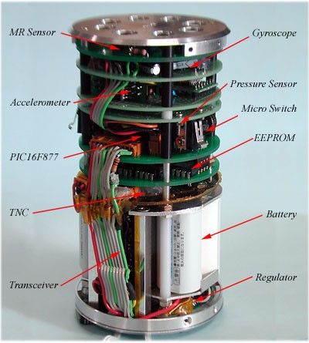
External Project: CanSAT
Auburn 2018 CanSat team will be competing in June in Stephenville, Texas.
Needs a volunteer EE student to help with building and programming CanSat probe
Travel cost to competitions are paid for.
Contact: Tristin Hollingsworth
tzh00044@auburn.edu
http://esero.ie/project/cansat-201516/

Slide 18
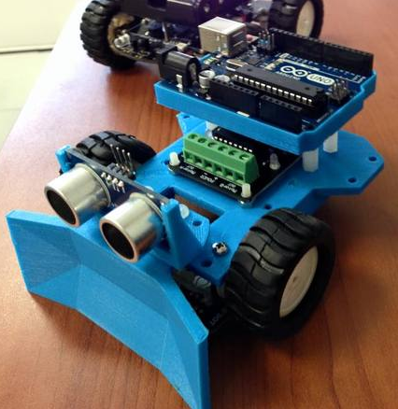
Competition Project: Sumo Robotics Tournament
Will be the final project for the Maker Training Sessions.
Attendance at Maker Training Sessions are not required to compete.
Will utilize many different topics in engineering
mechanical design
3D printing
electrical prototyping
sensor and control systems
C programming
https://www.thingiverse.com/thing:29827

Slide 19
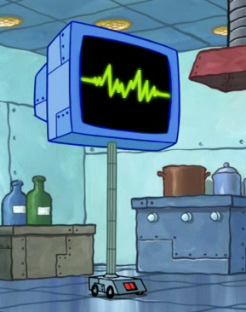
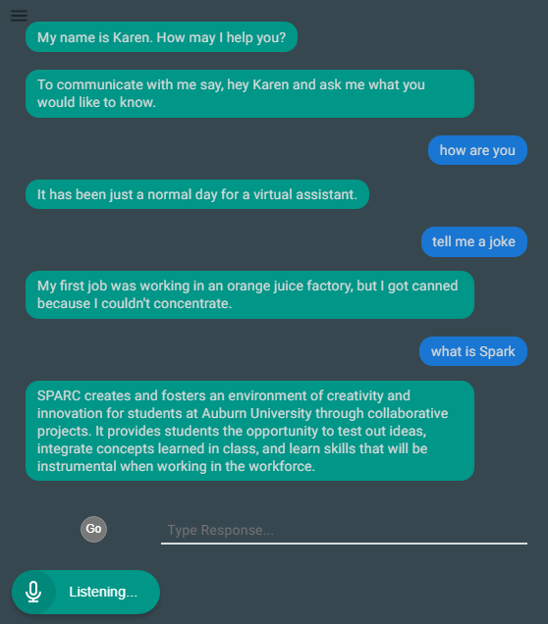
Demonstration Project: Lab Assistant
Kinematic
Autonomous
Robot
Enriches
Newcomers
Create an automated lab assistant.
Will be voice controlled.
Will consist of both a stationary and mobile system.
Will be embedded on the new group chat system Slack.
Programmed in Node.JS (Framework of JavaScript)
Semester Focus
Solidify base framework
Create device/client server control mechanism
Slack Channel
#projectlabassistant

Slide 20
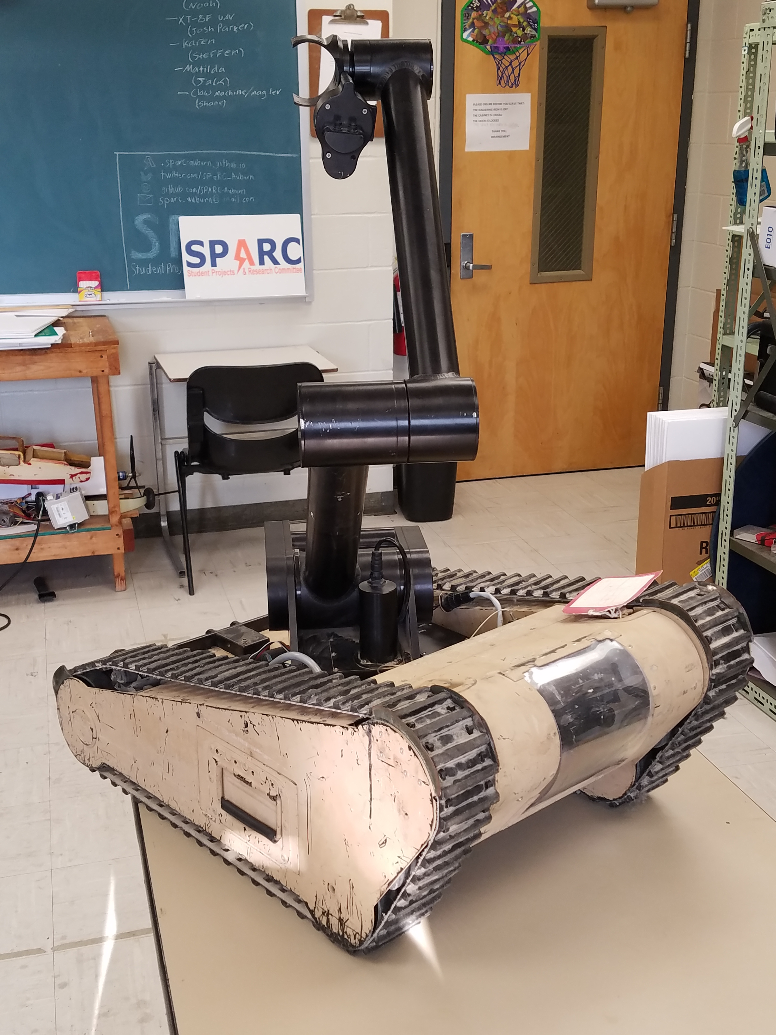
Demonstration Project: MATILDA
MATILDA stands for Mesa Associates' Tactical Integrated Light-Force Deployment Assembly
A bomb disposal robot from Dr. Roppel’s research lab.
Is in disrepair both electrically and mechanically.
Semester Focus
Reestablishing mobility.
Project Lead
Jack Thomas (jet0024@auburn.edu)
Meeting Time
Wednesdays at 12:00PM in SPARC Lab
Slack Channel
#projectmatilda

Slide 21
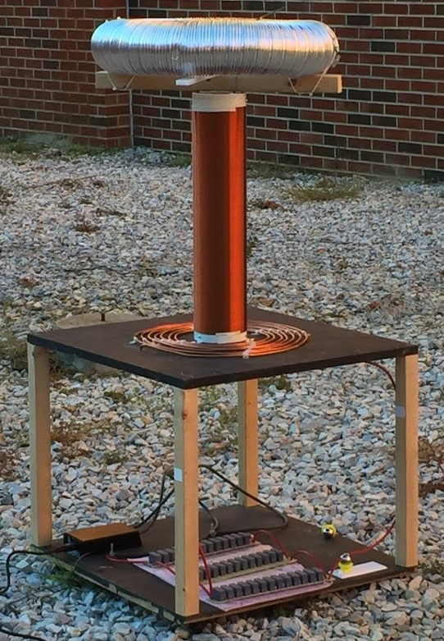
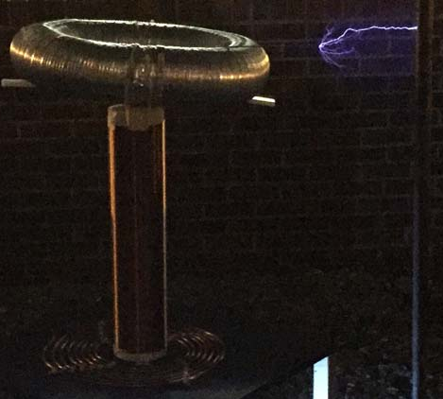

Demonstration Project: Tesla Coil
Demonstrated Tesla Coil at Spring 2016 E-Day
Use spark gap style circuitry
Generated estimated 400,000 volts of electricity.
Is in disrepair both mechanically and electrically
Semester Focus:
Make it operational again (new capacitors)
Potentially convert it into a musical Tesla Coil.
Slack Channel
#projectteslacoil

Slide 22
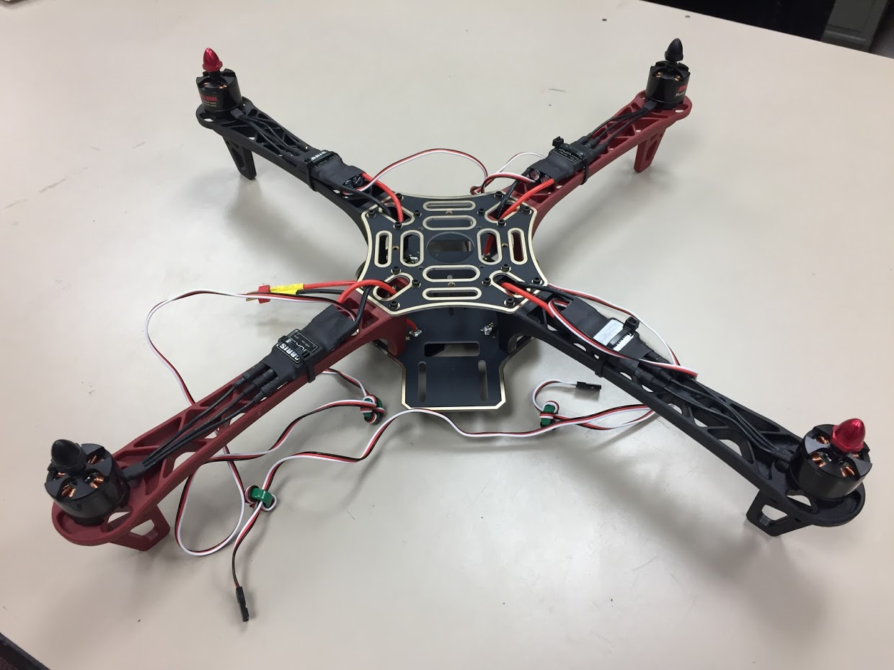
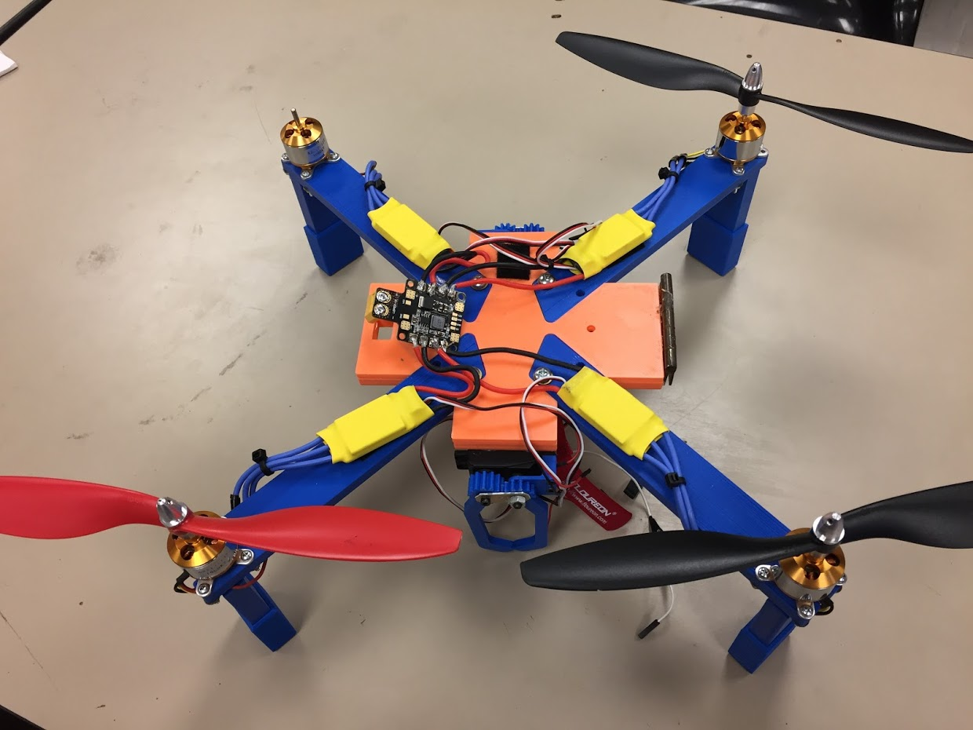
Research Project: Unmanned Aerial Systems (UAS)
Partnership with RC Hobbyist
SPARC owns two quadcopter frames.
Will be used to experiment with many applications
Autonomy- search and follow
Camera Gimbal- stable video capture
Payload- pickup, identification, and delivery
Semester Focus
Get at least one frame flying
Start looking into camera gimbal
Slack Channel
#projectuas

Slide 23
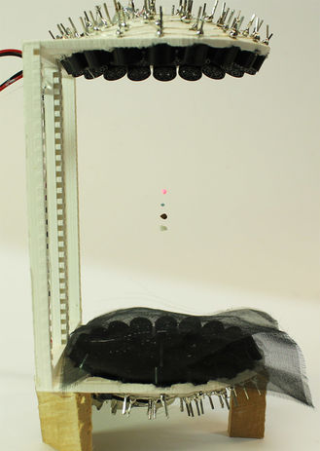
Demonstration Project: Acoustic Levitator
Create a 3D printed acoustic levitator
Will be able to suspend small particles
liquids
foam
ants
etc
Has instructable that describes project
http://www.instructables.com/id/Acoustic-Levitator/
E-Day demonstration project

Slide 24
Other Project Ideas?

